Slide 1
‘Fair Trade’

Slide 2
In this lesson we will explore issues relating to youth violence by analysing a short film called ‘Fair Trade’.
Do now: Write your name and fill in the first orange box on your feedback form and leave it to one side.

Slide 3
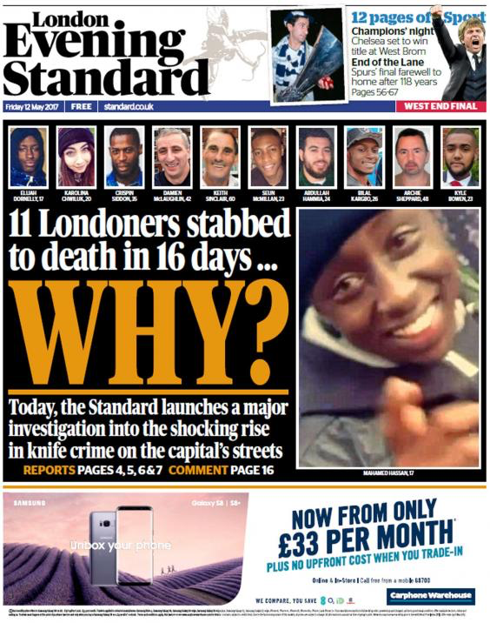
Notes:
Questions:
Who has seen reports about knife crime in their area?
How do these headlines make you feel?
Do these headlines give you the full story? Why?

Slide 4
What is ‘youth violence’?
perpetrator verbal
aggressive 10
knives young
adults children
hitting
Violence involving …………… people, typically ………………., adolescents, and young ……….. between the ages of …. and 24. The young person can be the victim, the ………………………, or both. Youth violence includes ………………. behaviours such as …………. abuse, bullying, …………….., fist fighting, or using weapons such as guns and ………….. .
Notes:
Missing words in order: young, children, adults, 10, perpetrator, aggressive, verbal, hitting, knives

Slide 5
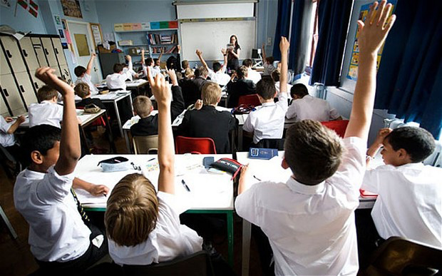
We’ve looked at the headlines, and we’ve looked at the definition of youth violence… but do these fully explain why it happens?
Think, pair and share: What might be the reasons for youth violence? Who is to blame?
Notes:
Questions:
Why might a young person be the victim of youth violence?
Why might a young person be a perpetrator of youth violence?

Slide 6
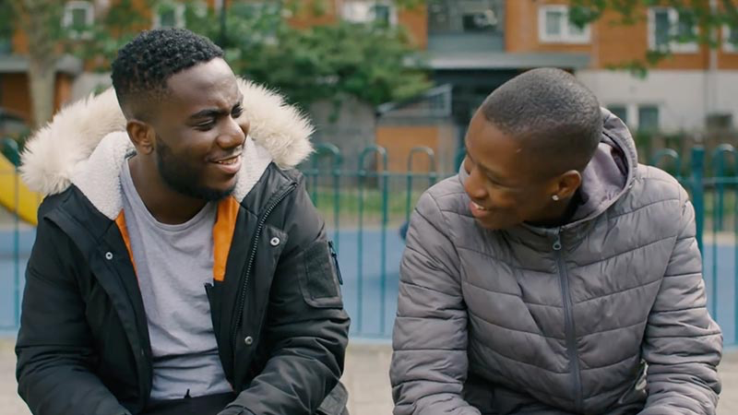
What do you think could be happening in this picture?
Notes:
Questions:
Are they friends?
Are they family?
What could they have in common?
Do you think they have a good relationship?
What would you think if you passed them in the street?
If you don’t think they’re friends or family, how else might they know each other?

Slide 7
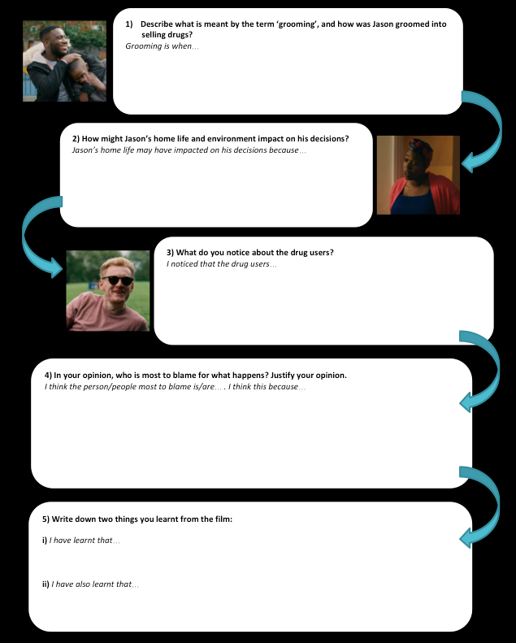
Notes:
Explain to students that they will now watch the film (note the timings on the following slide regarding scenes of drug use and violence).
Students will have this worksheet to fill out, which can be done during the film. They will have time to complete the worksheet after the film as well.

Slide 8
Notes:
Film link: https://www.youtube.com/watch?v=0Y61hHnZ1Ro
Timings to note (film shows drug dealing throughout):
0:00 – 0:33 Beginning of knife attack (but cut short)
5:09 – 5:36 Drug use.
12:35 – 13:01 Drug use.
13:05 – 14:08 Knife attack.
14:32 – 15:13 Drug use.

Slide 9
Notes:
Students can be given time to complete the worksheet.
Bonus questions can be given to those students who finish.

Slide 10
You will now be put into groups.
Each group will be given a mystery question. You have 5 mins to discuss your question, and come up with a group answer.
Each group will then feedback, and ‘teach’ the rest of the class about what they discussed.
When ‘teaching’ the class, you should:
Describe the question you selected
State your group’s answer to the question
Justify how you arrived at this answer.

Slide 11
Who can you talk to?
Parents/guardians, or a relative you’re close to.
Your favourite teacher, form tutor or head teacher.
Childline: 0800 1111 (if you need support on anything that’s been discussed)
Crimestoppers: 0800 555 111 (if you know about a crime)
knifefree.org.uk (support on staying knife-free)
fearless.org (100% anonymous crime reporting)
Always call 999 if it’s an emergency, or you know someone who is at risk.

